Slide 1
Space Time Card
Detailed Design Phase
Eva Czukkermann, Ian Dolfi, Nsadhu Muyinda, Drew Schacke, Luke Schrom, Tanner Smith

Slide 2
Overview
Individual and Team Vision
Feasibility: Analysis, Simulations
Feasibility: Prototyping
Drawing, Schematics, Diagrams
Bill of Materials (BOM)
Test Plans
System Design and Flowcharts/System Block Diagram
Risk Assessment
Open Items
Project Management
Goals for Next Phase
Notes:
Tanner

Slide 3
Individual and Team Vision:
Planned: Design breakout PCB for MicroZed 7010 SoM, and attempt layout for final time card product. Furnish DPPL MATLAB model including additional environmental, clock aging, and supply stability characteristics. Furnish and assemble the Raspberry Pi GNSS testbench. Within any spare time the Open Compute Time Card design was to be analysed further to reuse or repurpose design elements.
Accomplished: The development breakout board for the MicroZed 7010 SoM was developed. The overall timecard PCB design was started with many elements still needing some time. Upon discussion both existing and future designs should be reviewed by a qualified individual (Professor Carlos Barrios). The Raspberry Pi GNSS testbench was partially assembled, due to MSD ordering issues. The MATLAB (Simulink) DPPL simulations encompassed the main erroneous characteristics. The 3d models of the current state of the timecard were generated
Notes:
Tanner

Slide 4
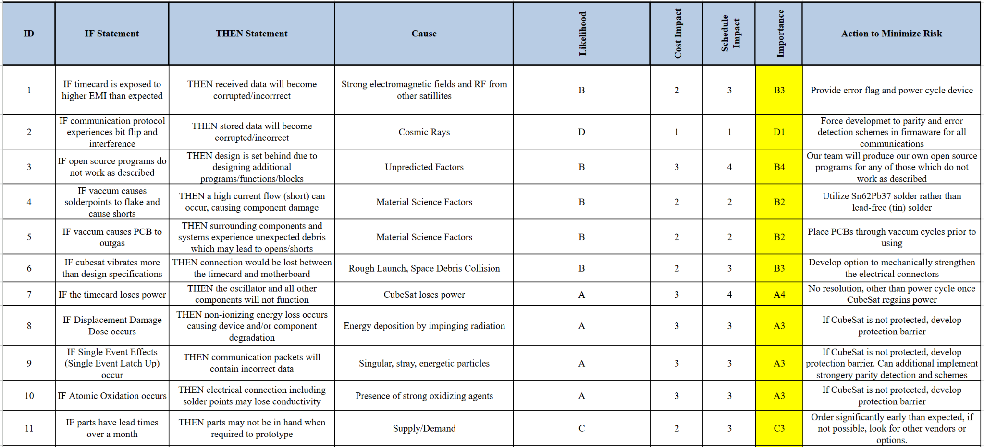
Risk Assessment:
Notes:
Drew

Slide 5
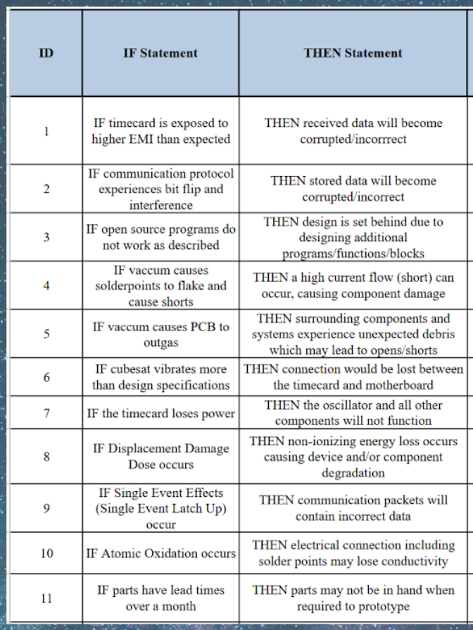
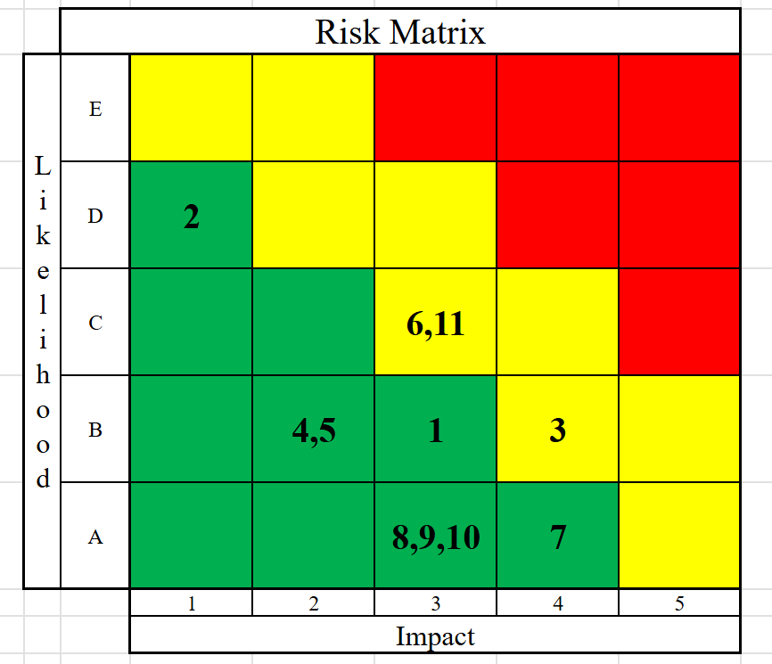
Notes:
Drew

Slide 6
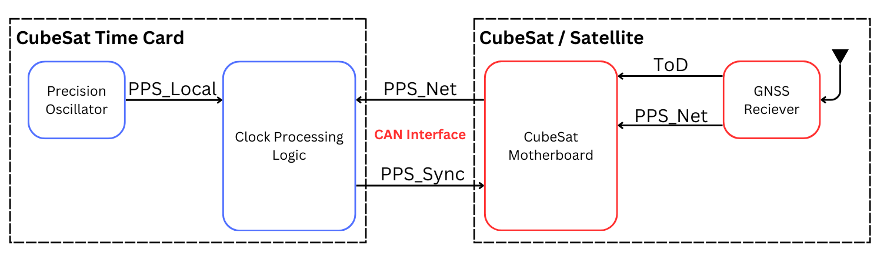
System Design Flowchart: High Level
Note: No amendments were made since last meeting to the system functionality flowcharts.
Notes:
Tanner

Slide 7
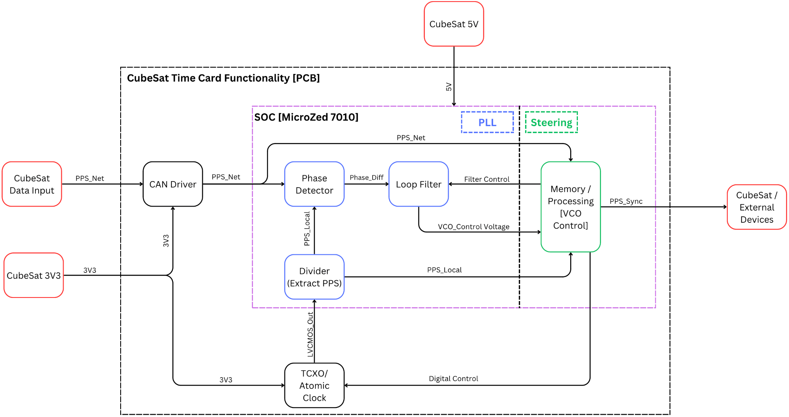
System Design Flowchart: Board Functionality
Notes:
Tanner

Slide 8
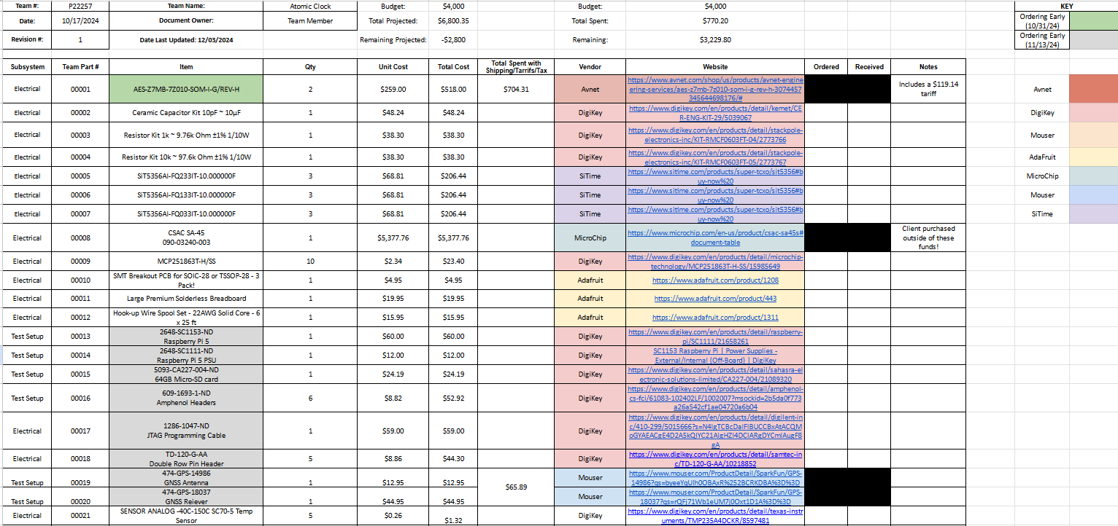
Bill of Materials (BOM)
Notes:
Drew

Slide 9
Bill of Materials (BOM)
BOM Highlights
Total our team has spent: $770.20
Leaves $3,229.80 remaining from our $4,000
Total client spent for us: $5,792.33
Total invested: $6,562.53
Notes:
Drew

Slide 10
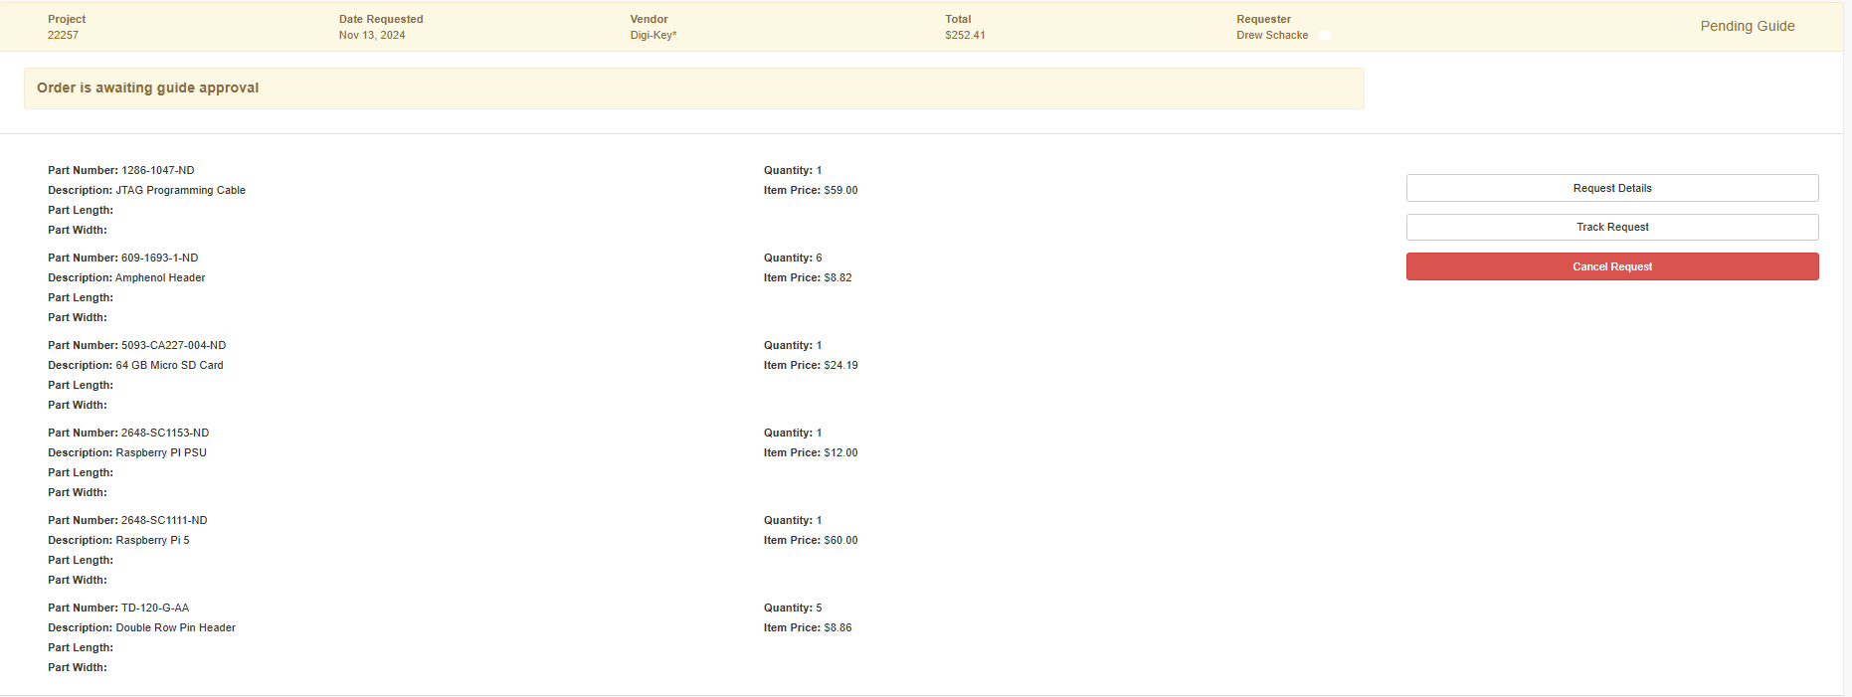
Bill of Materials (BOM)
Pending Order Total: $252.41
resulting in a total invested during MSD1 of $6,814.94
Notes:
Eva

Slide 11
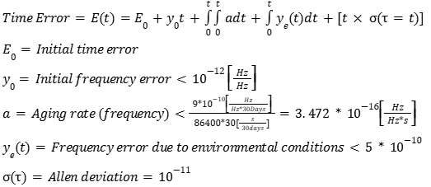
Feasibility: Holdover Specifications
The SA-45 CSAC datasheet does not directly give holdover specifications, but we can calculate expected holdover error from the given values
No corrections
If we can fully correct for aging and environment

Slide 12
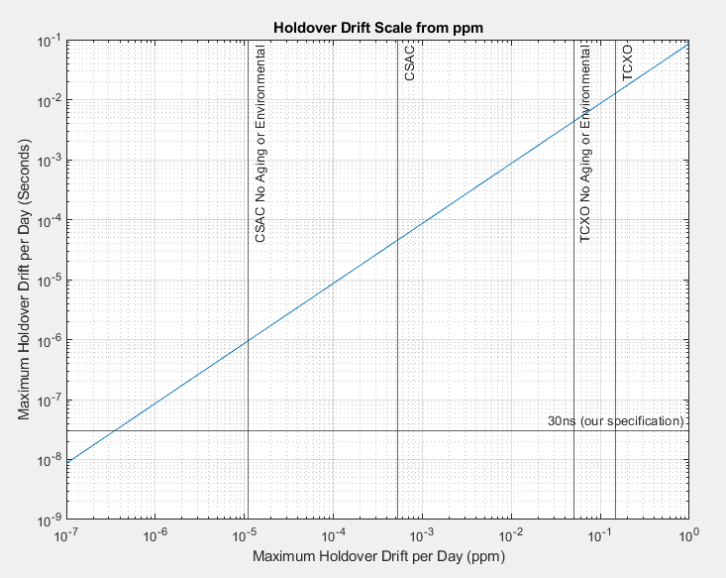
Feasibility: Holdover Specifications
Comparison of holdover specification in ppm to maximum time drift in seconds. The range we expect to fall within is between “CSAC” and “CSAC No Aging or Environmental” for the SA-45 or between “TCXO” and “TCXO No Aging or Environmental” for the SiT5356

Slide 13
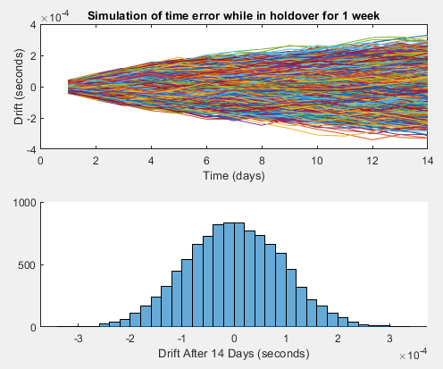
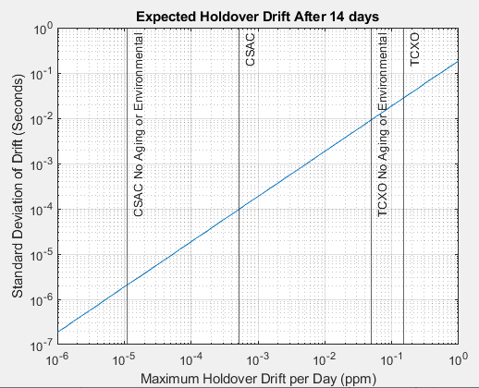
Feasibility: Holdover Specifications
Simulation snippet at 0.5ppb
Standard deviation of time drift after 2 weeks of holdover

Slide 14
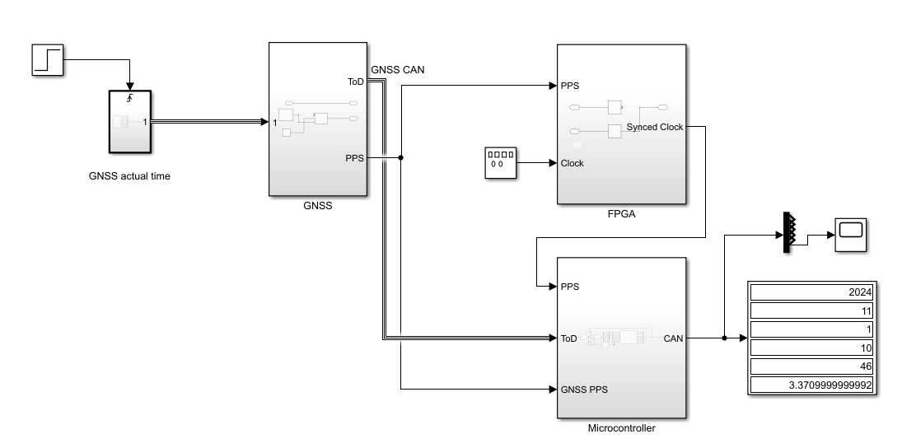
System Model
Notes:
Luke

Slide 15
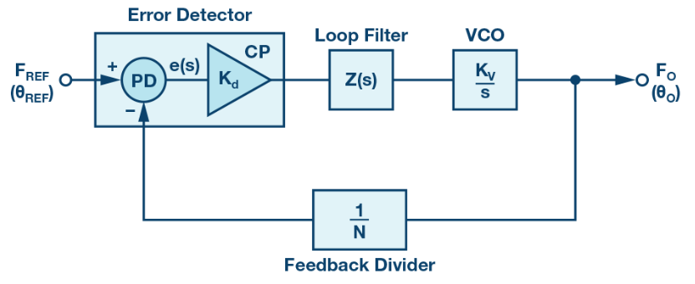
PLL Overview
Locks onboard oscillator to GNSS time
VCO: Voltage-controlled oscillator
The onboard oscillator
F_{ref}
Reference GNSS PPS signal
Error Detector
Outputs a value based on the phase difference between the onboard PPS and the GNSS PPS
Loop Filter
Filter for gradually adjusting clock based on phase error. Uses control theory for stability.
https://www.analog.com/en/resources/analog-dialogue/articles/phase-locked-loop-pll-fundamentals.html

Slide 16
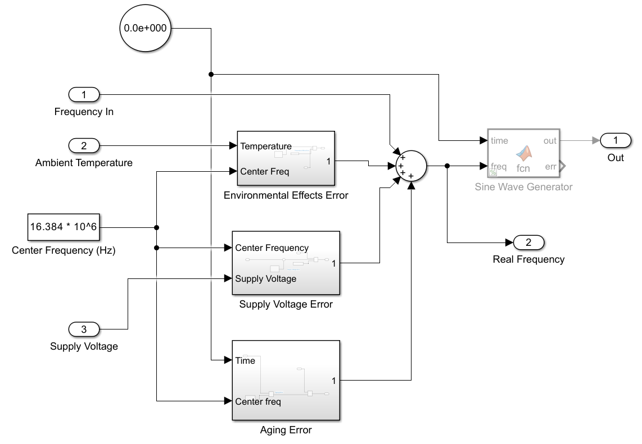
Realistic Oscillator
Simulink subsystem based on the SA-45
Implements deterministic errors (allan deviation to be added)
Outputs a “real frequency” number instead of actual sine wave for reasonable simulation speeds

Slide 17
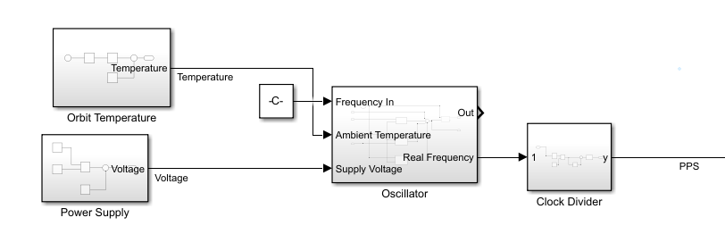
Oscillator Context
Power supply ripple
Varying temperature in orbit
Clock divider using “real frequency” value

Slide 18
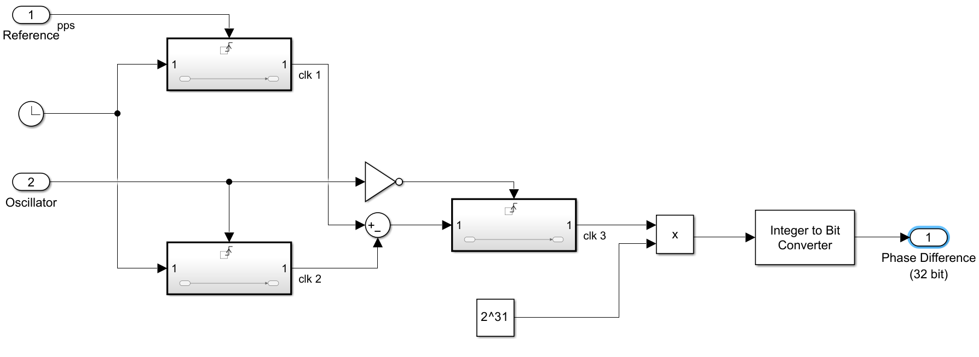
Error Detector
Outputs 32-bit value based on timing differences between the input PPS phases

Slide 19
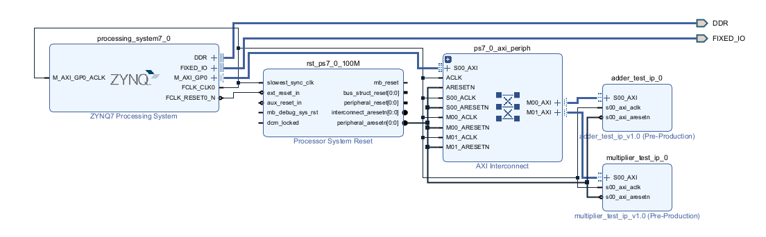
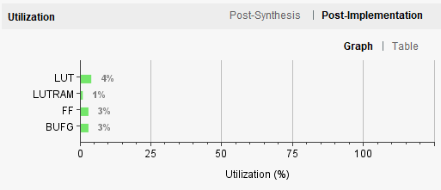
Feasibility - Embedded Environment
Notes:
Eva

Slide 20
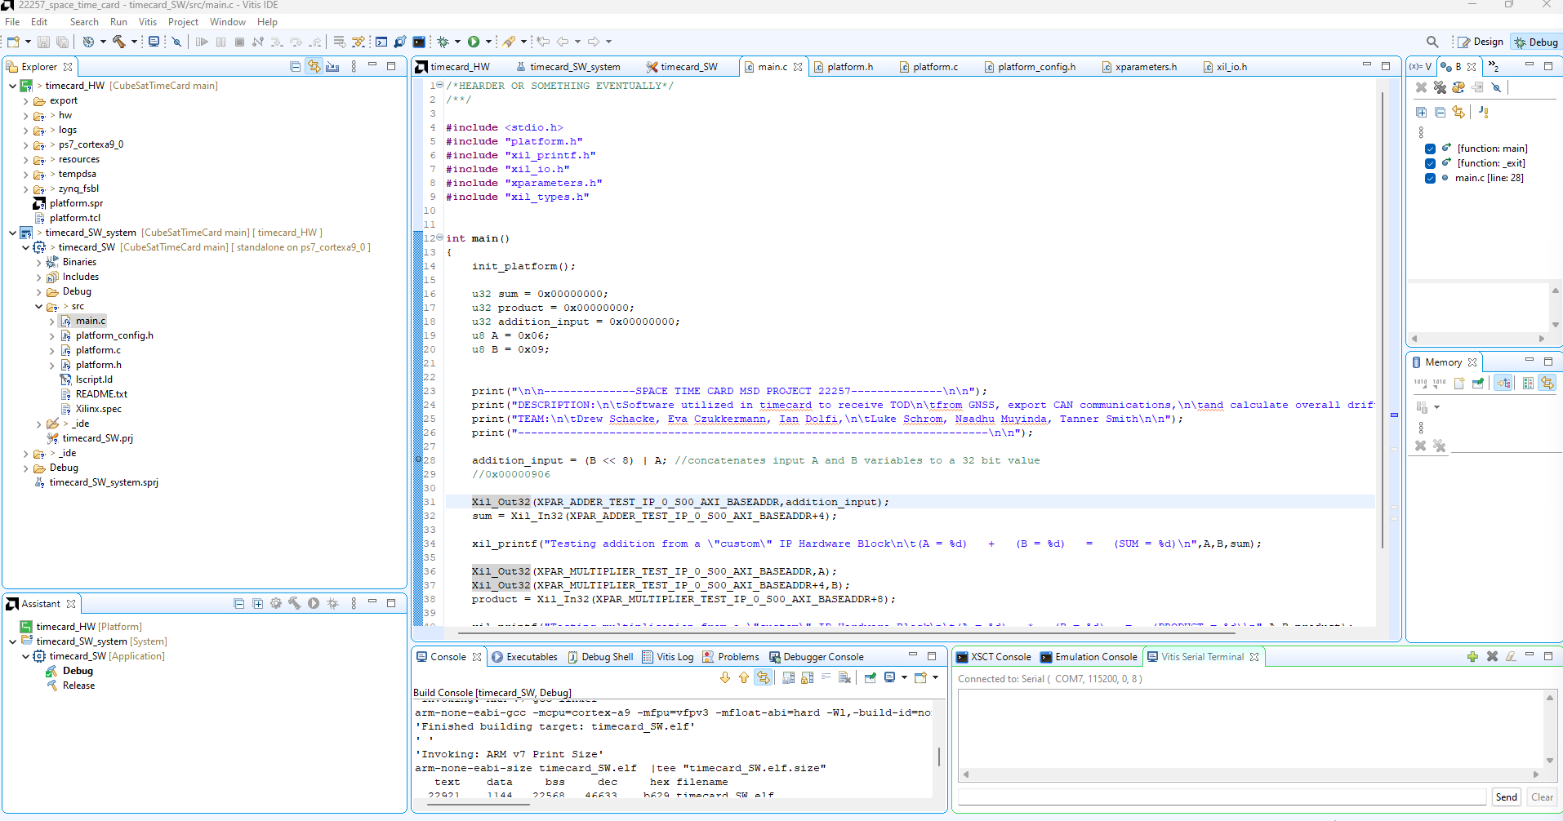
Feasibility - Embedded Environment
Notes:
Eva

Slide 21
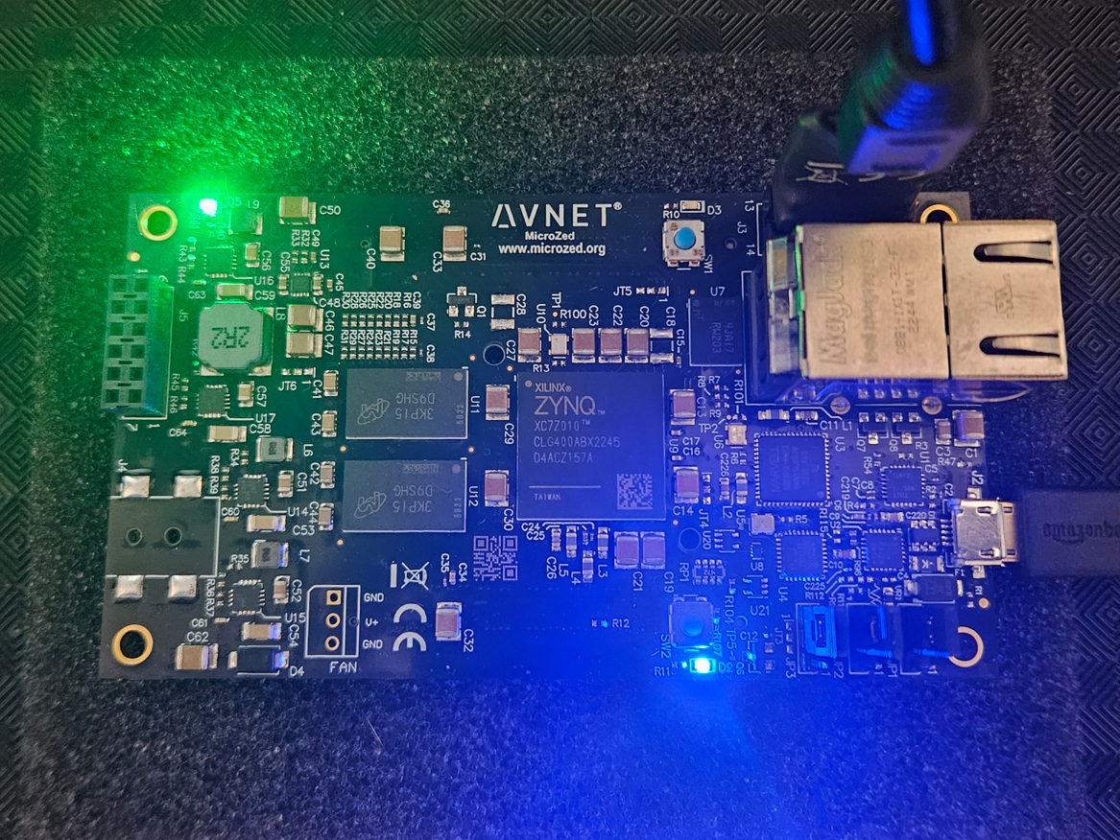
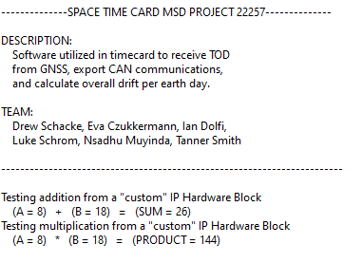
Feasibility - Embedded Environment
Notes:
Eva

Slide 22
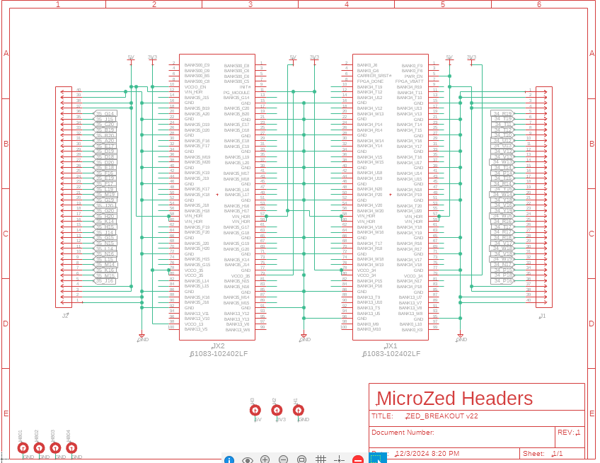
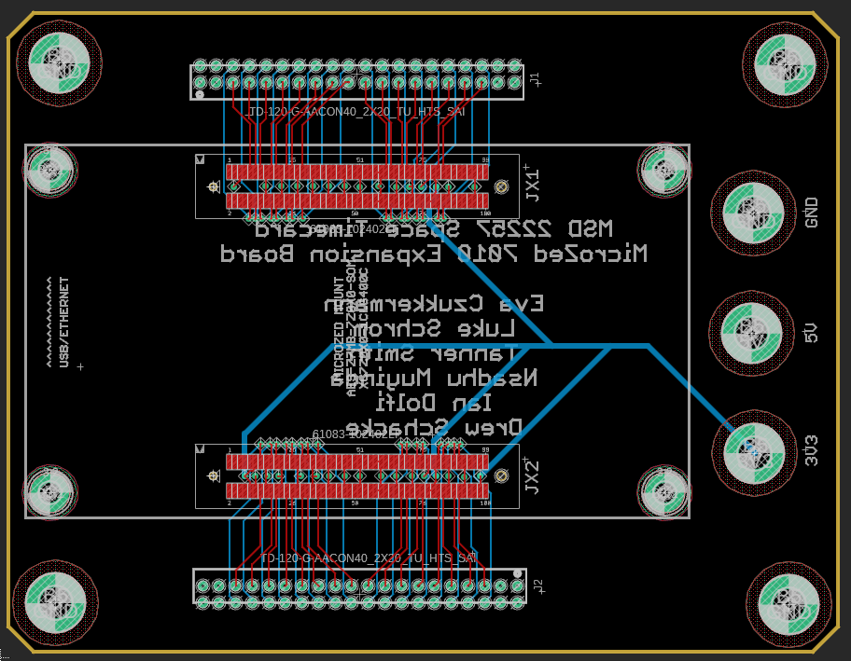
MicroZed Expansion Board
Notes:
Eva

Slide 23
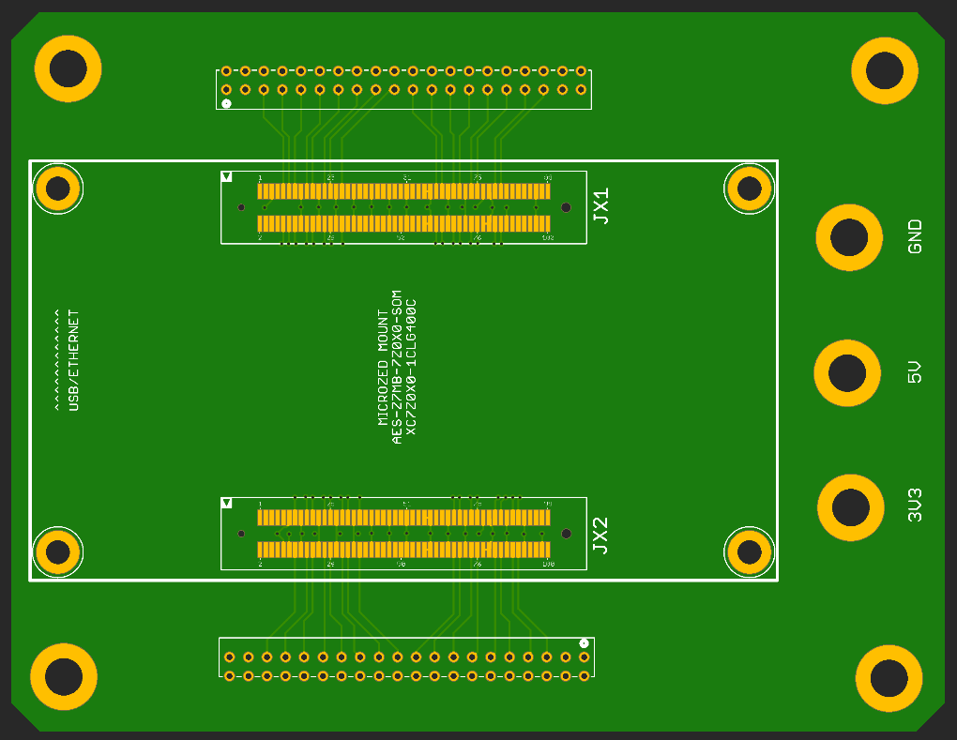
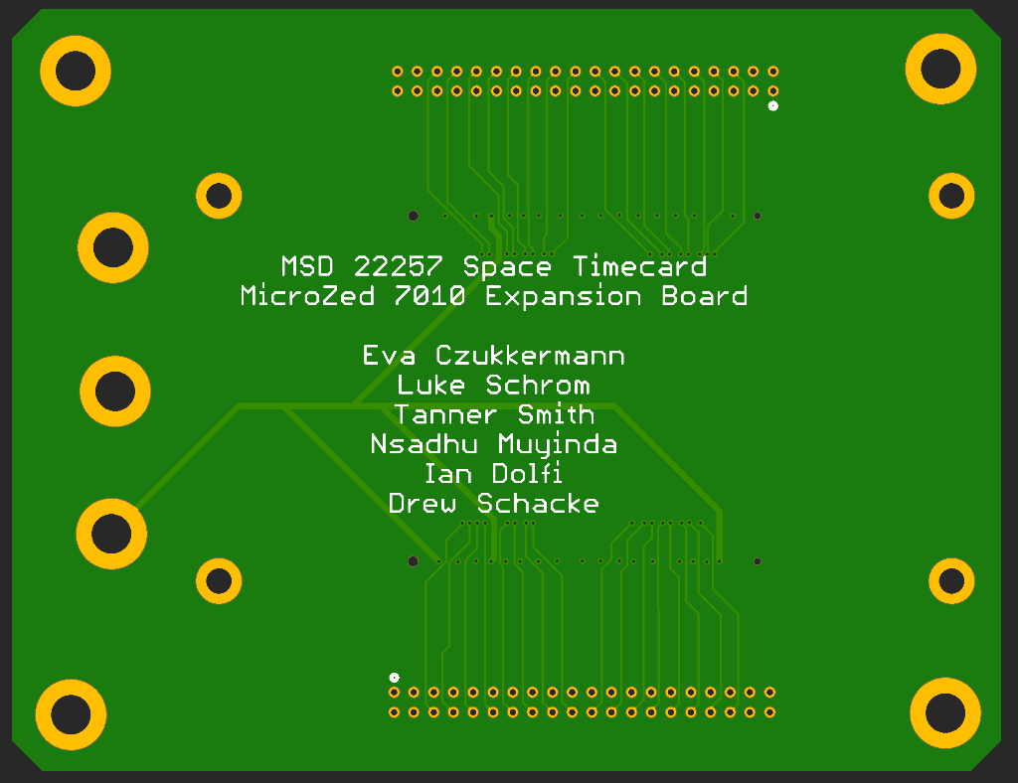
MicroZed Expansion Board
Notes:
Eva

Slide 24
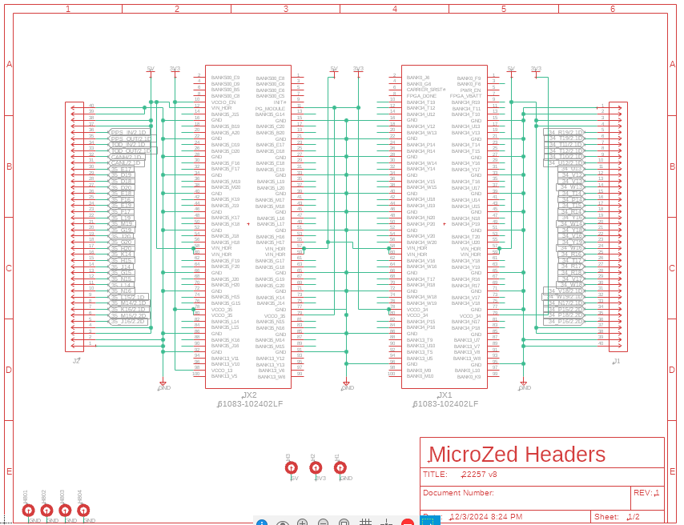
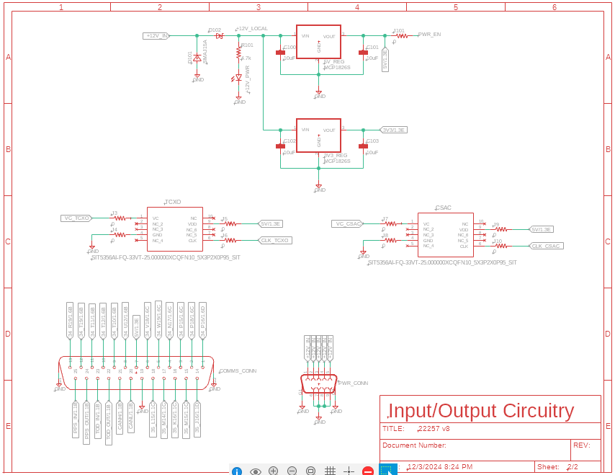
Working PCB Schematics/Board Files
Notes:
Eva

Slide 25
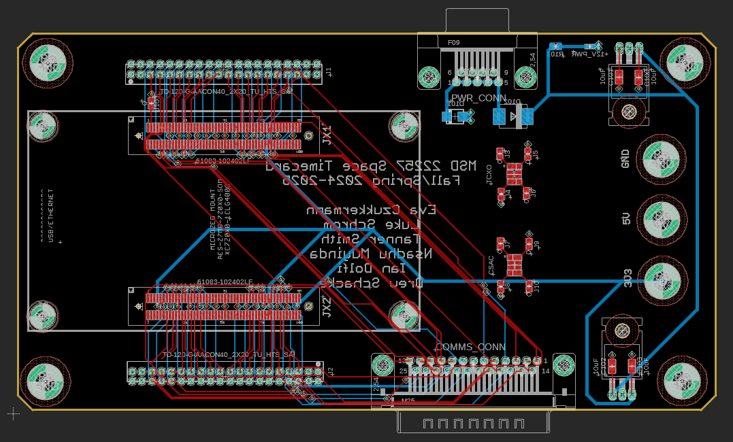
Working PCB Schematics/Board Files
Notes:
Eva

Slide 26
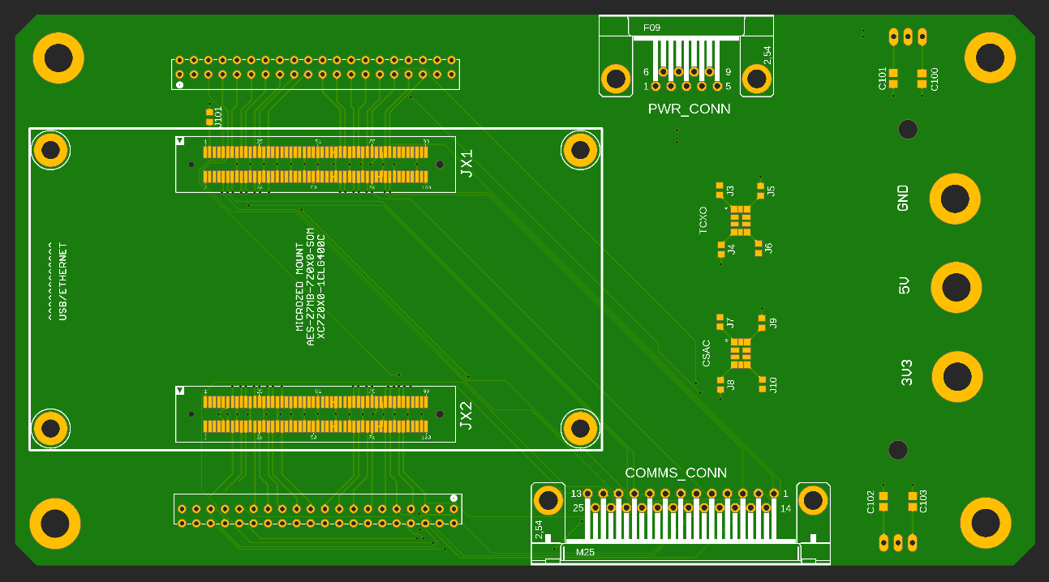
Working PCB Schematics/Board Files
Notes:
Eva

Slide 27
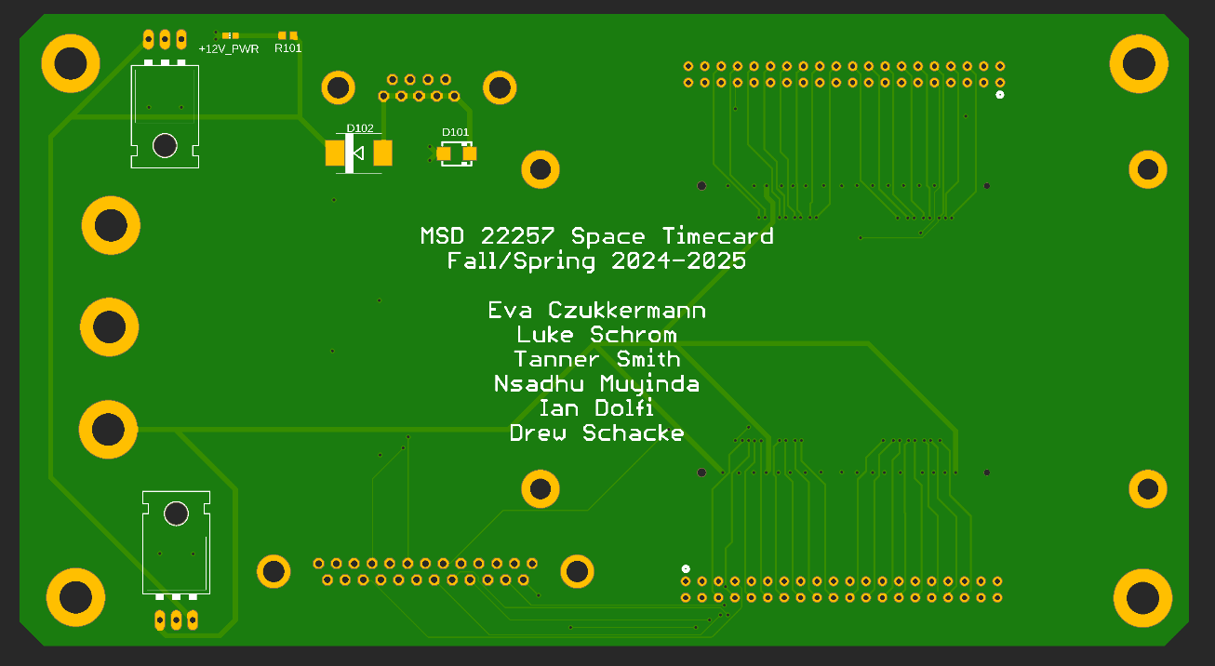
Working PCB Schematics/Board Files
Notes:
Eva

Slide 28
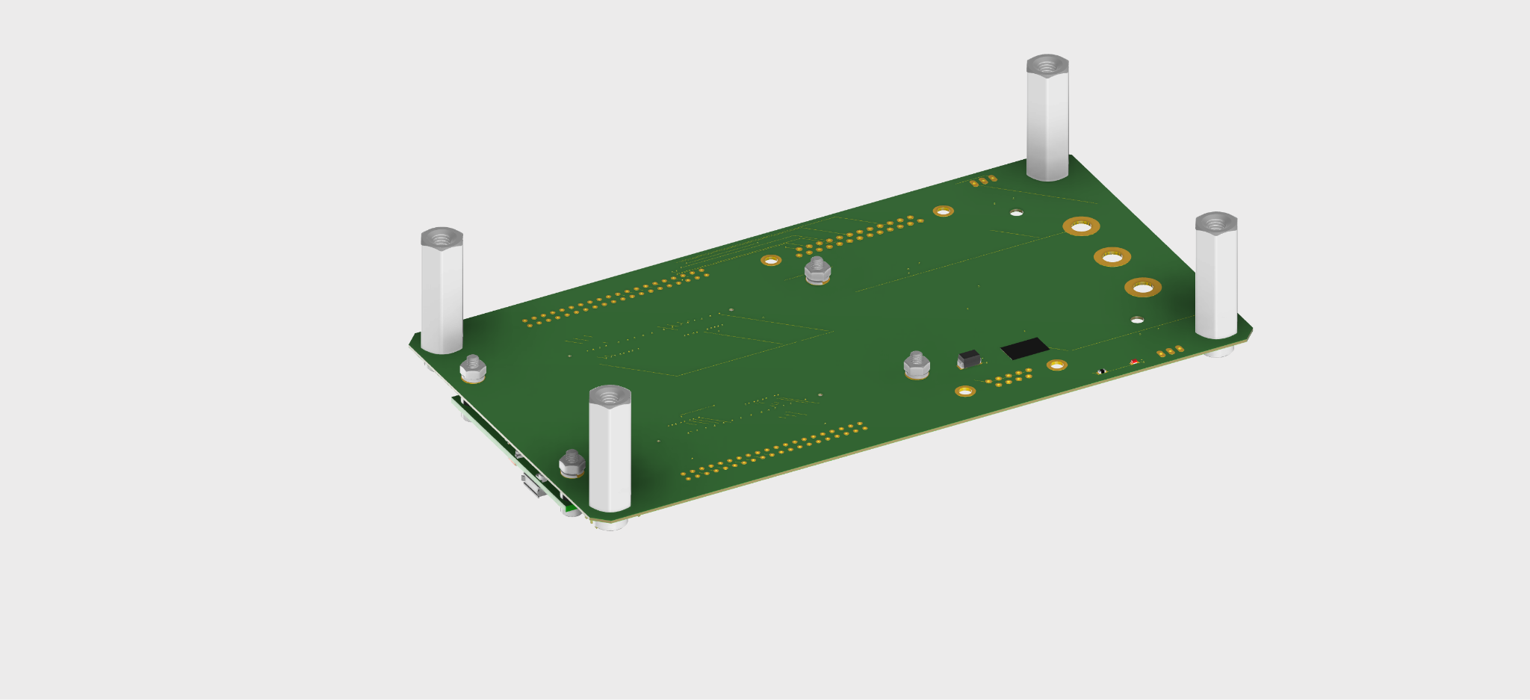
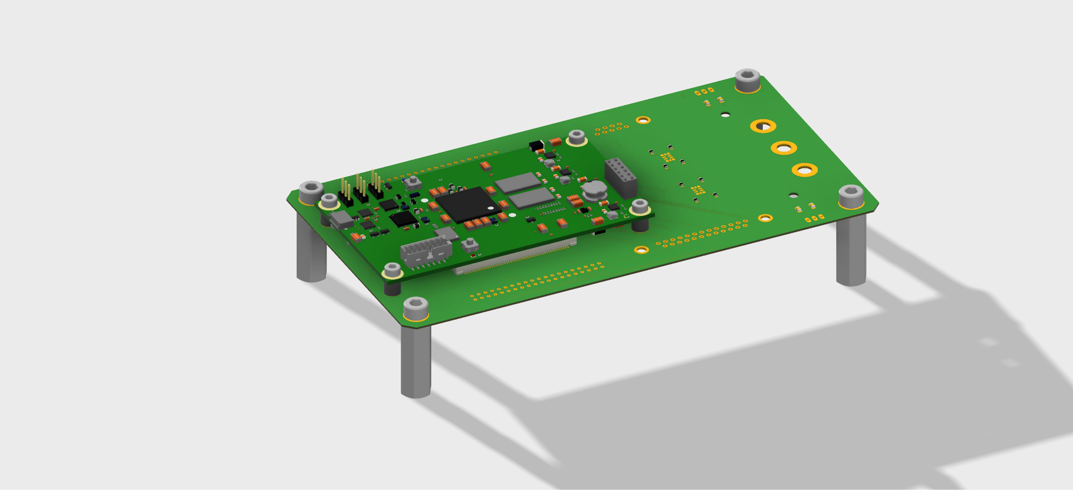
Board Assembly
Standoffs keep Time Card suspended in air to allow space for components underneath
SOC
Split lock washer and nut securely fasten SOC to Time Card
Room for CSAC
Time Card
Notes:
Eva

Slide 29
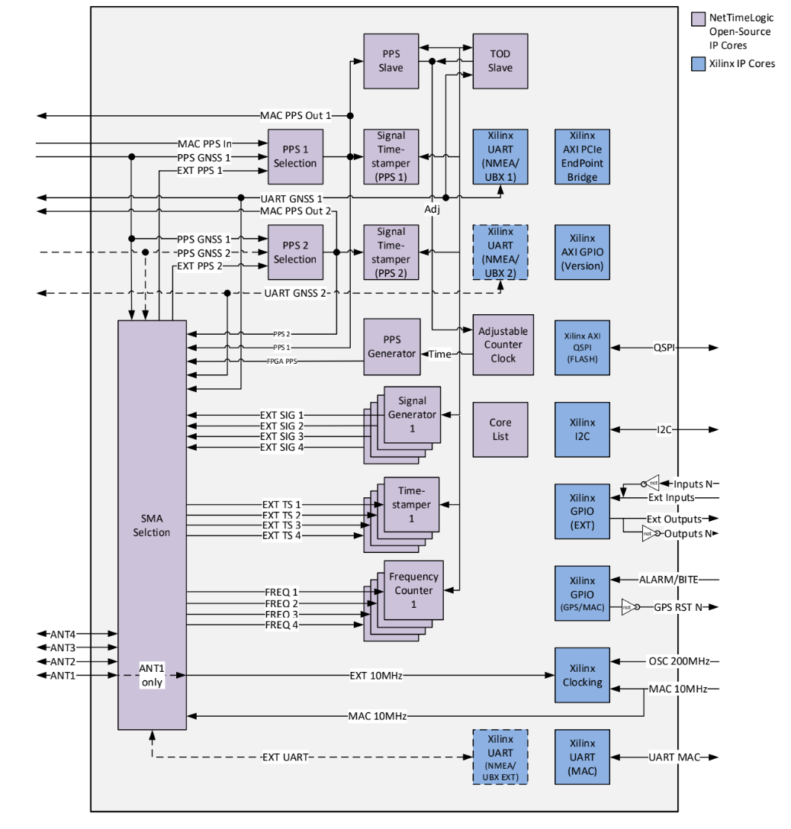
Feasibility - IPs from Meta
Notes:
Eva

Slide 30
Feasibility - IPs from Meta
Clock Detector
Detects the available clock sources and selects which to use.
Selects a clock based on priority.
Pulse per second (PPS) Slave
Calculates the offset and drift corrections to synchronize the local clock to a PPS signal.
Adjustable Clock
Handles time sets, offset (phase), and drift (frequency) adjustments from up to 5 sources.
Receives the offset (phase) and drift adjustment values (frequency) from PPS Slave.

Slide 31
Feasibility - IPs from Meta
Time of Day(Tod) Slave
Synchronises the system’s time to a Tod source over UART.
PPS Generator
Generates a PPS pulse using the local clock.
Communication Selector
Selects the communication interface to use between the FPGA and the oscillators.

Slide 32
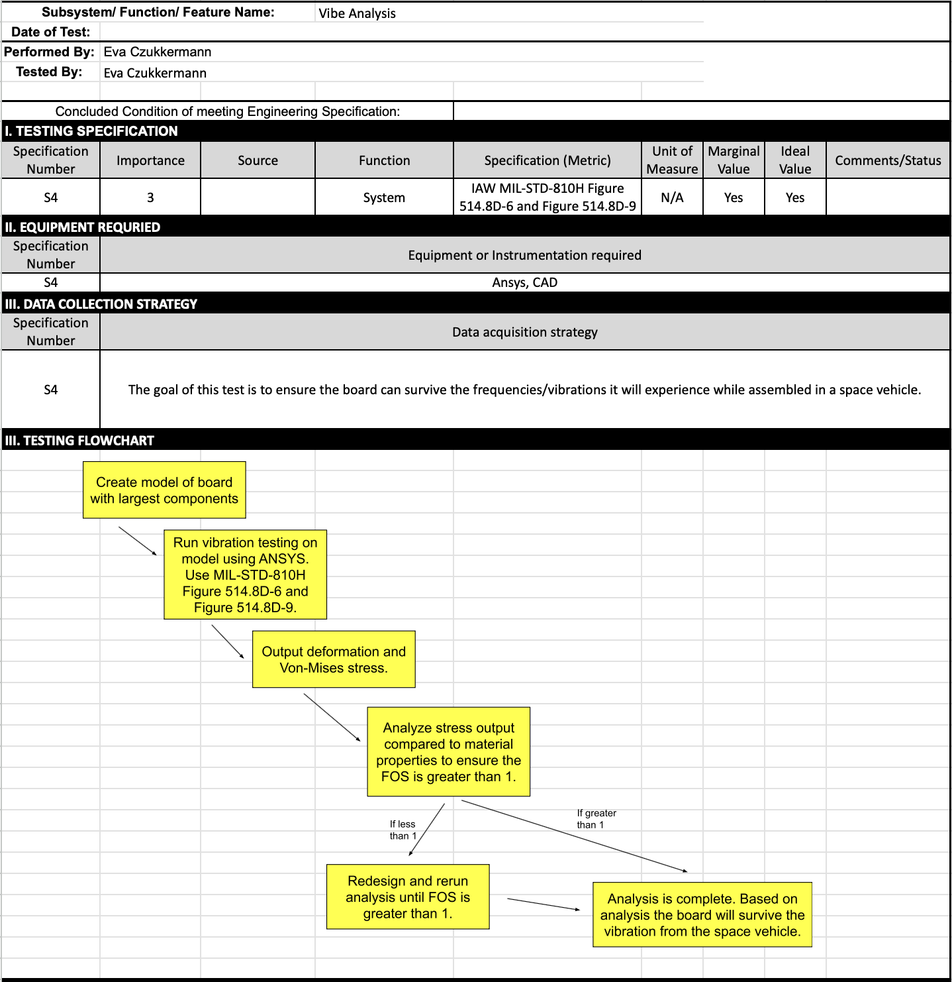
Test Plan: Vibe Analysis
Notes:
Nsadhu

Slide 33
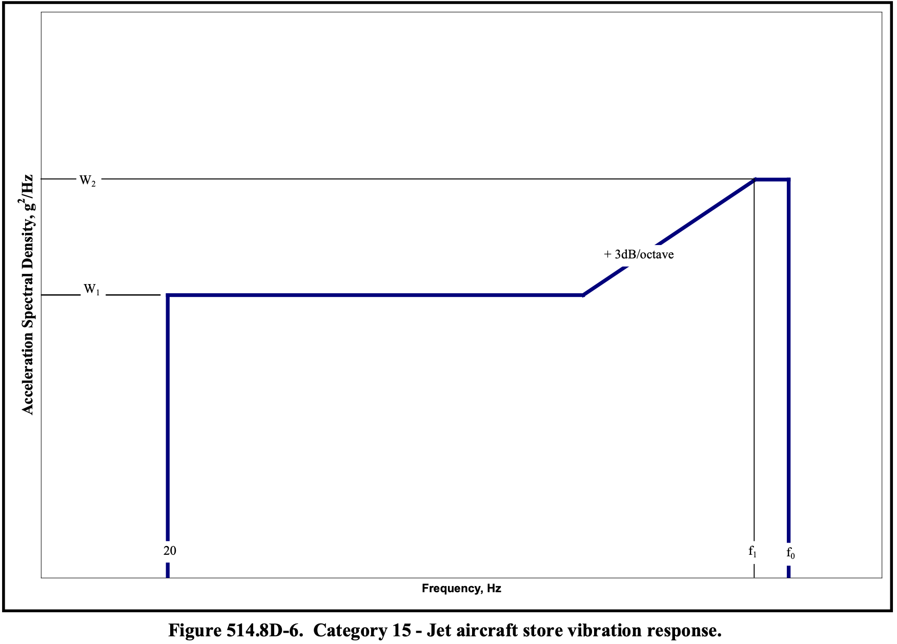
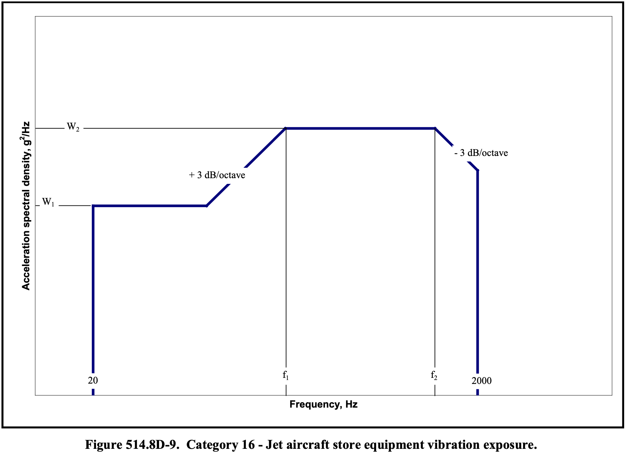
Vibe Analysis Specifications: MIL-STD-810H
Notes:
Nsadhu

Slide 34
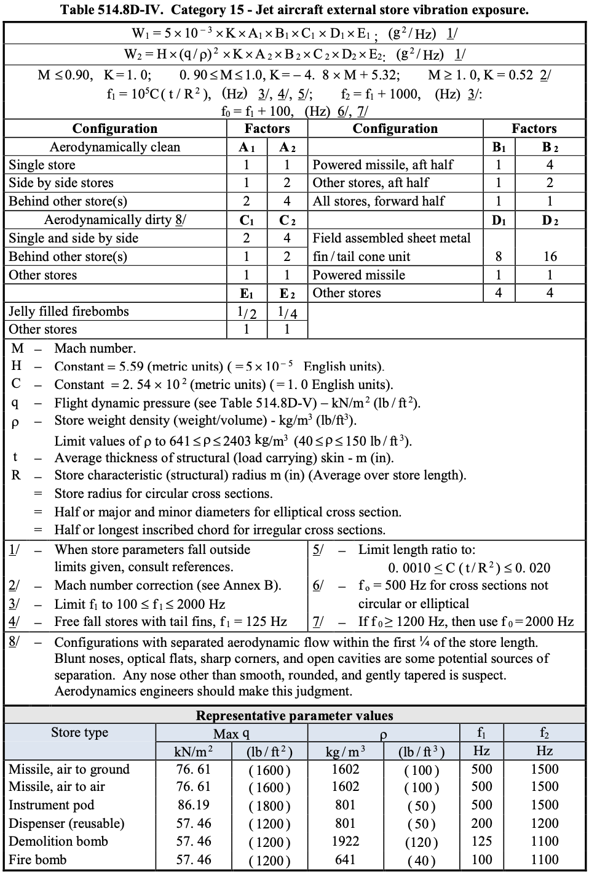
Notes:
Nsadhu

Slide 35
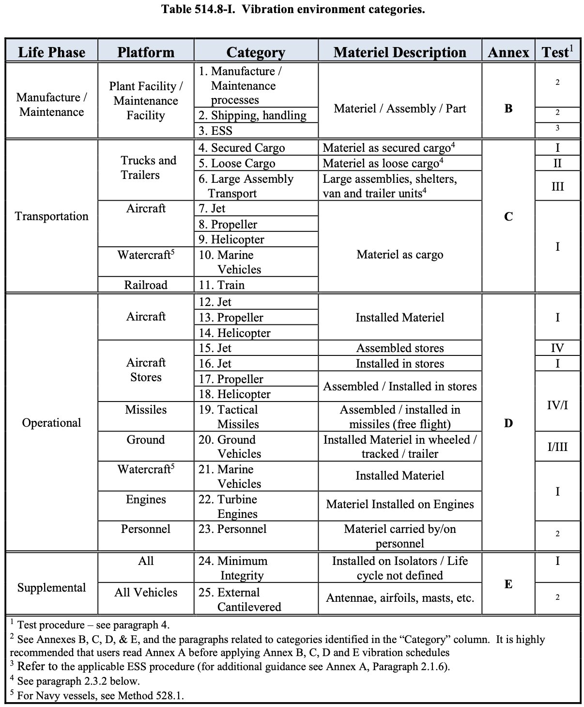
Notes:
Missile most closely aligns with launch vehicle time card would be on - points to Test I and IV

Slide 36
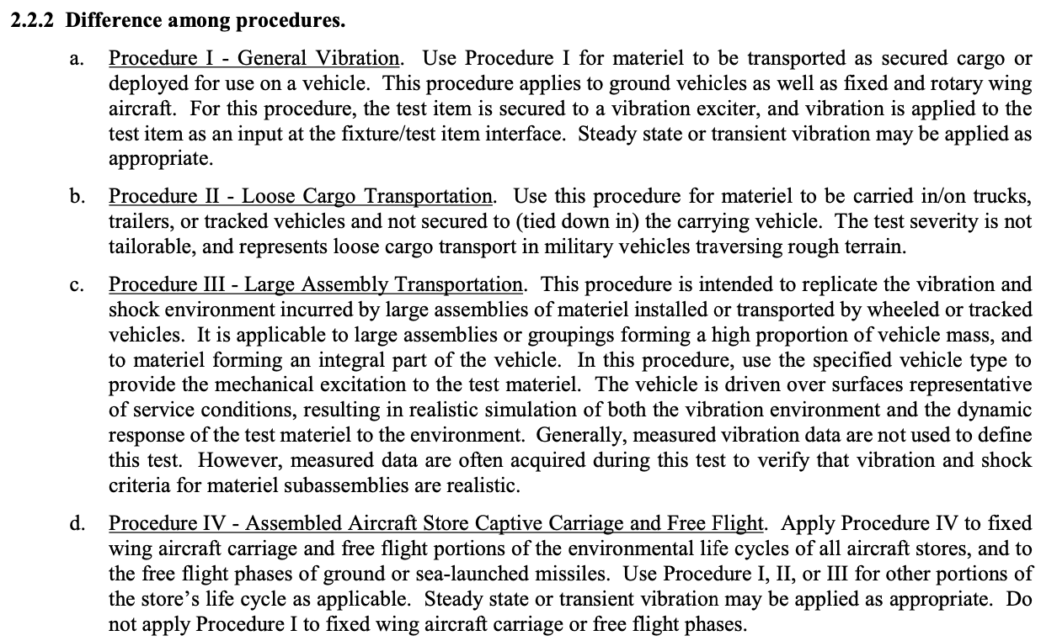

Slide 37
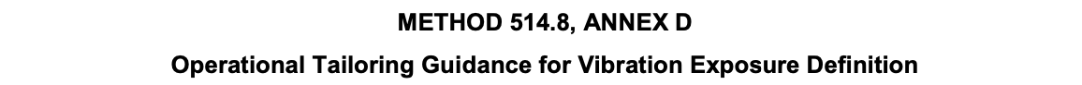
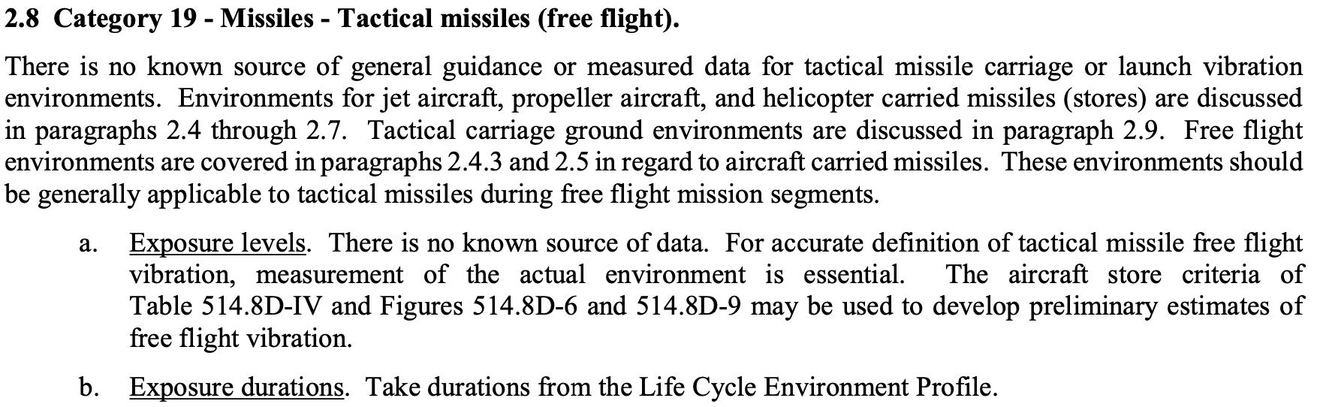
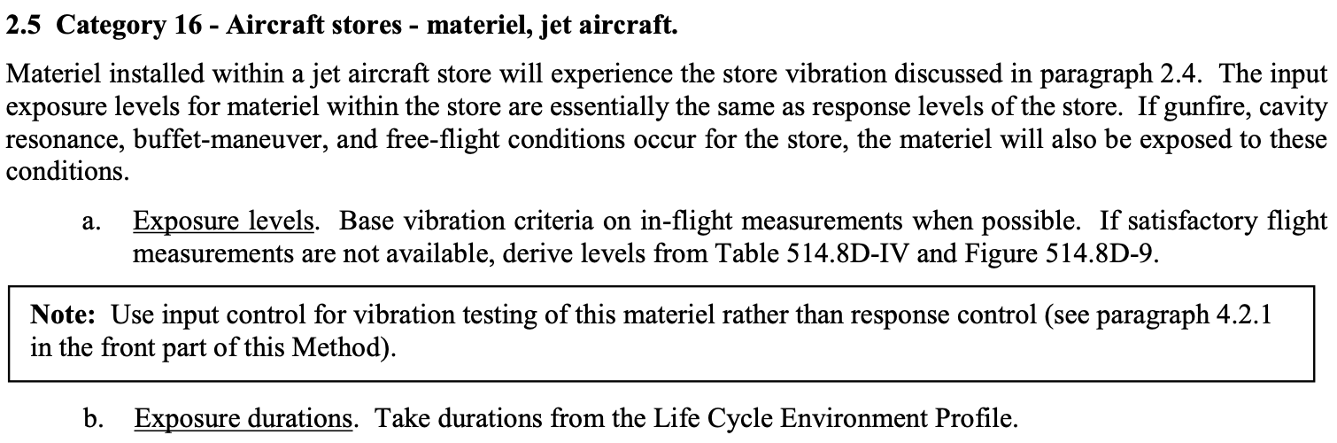

Slide 38
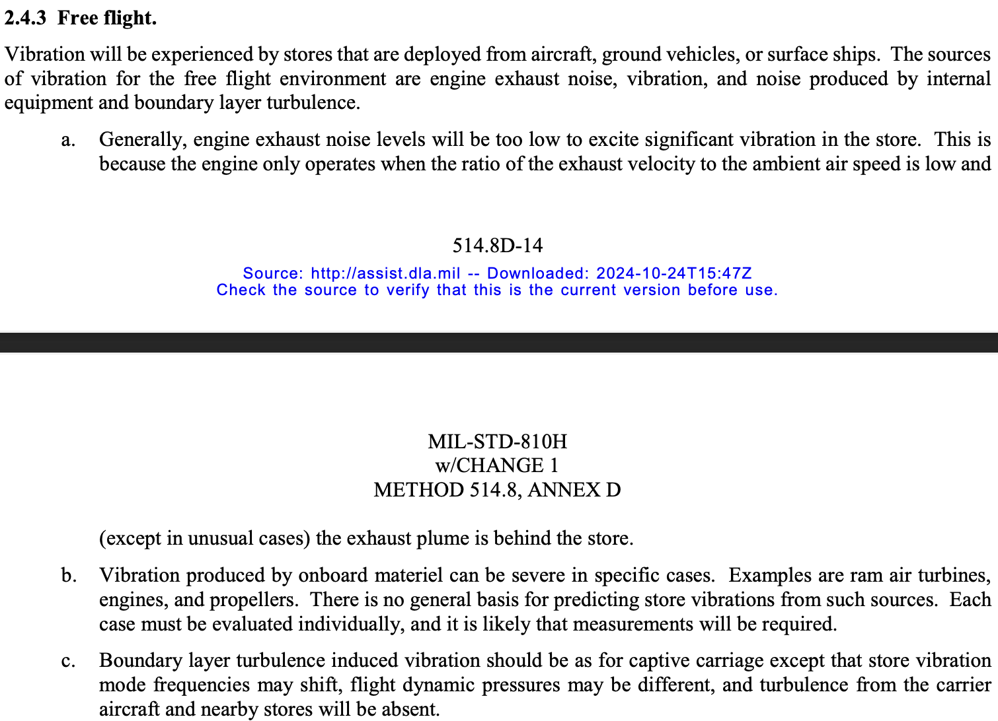

Slide 39
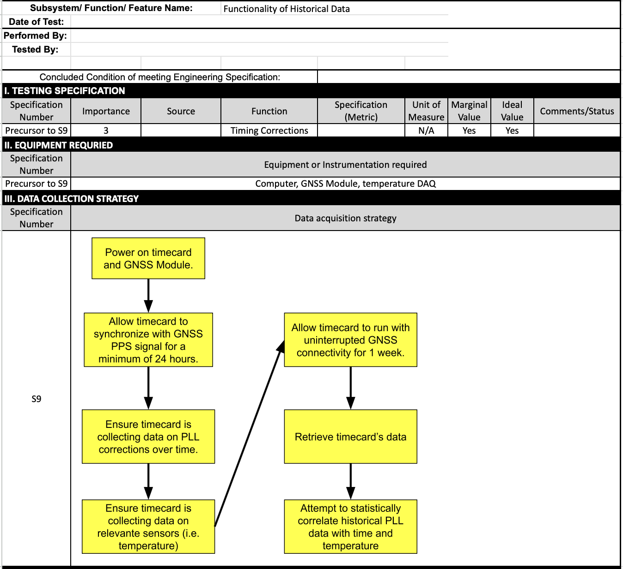
Test Plan: Historical Data
Capture
Test plan to verify functionality of historical data capture. This allows us to create statistical models to actively steer the oscillator while in holdover to reduce phase error.
Not directly related to ER.

Slide 40
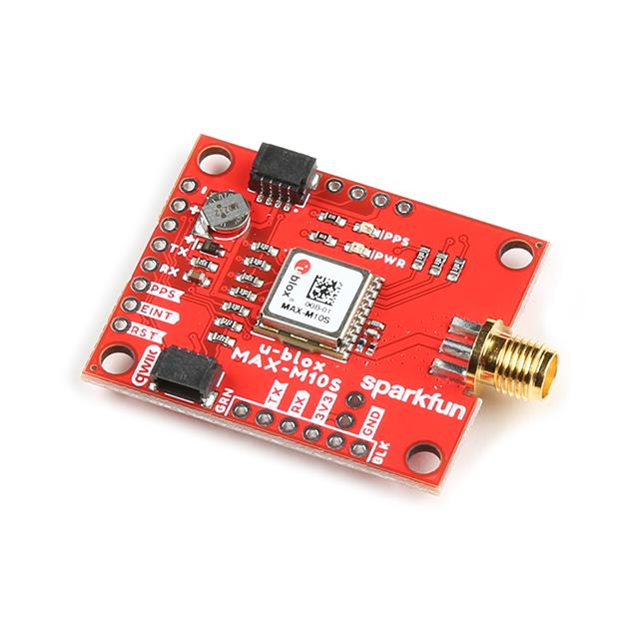
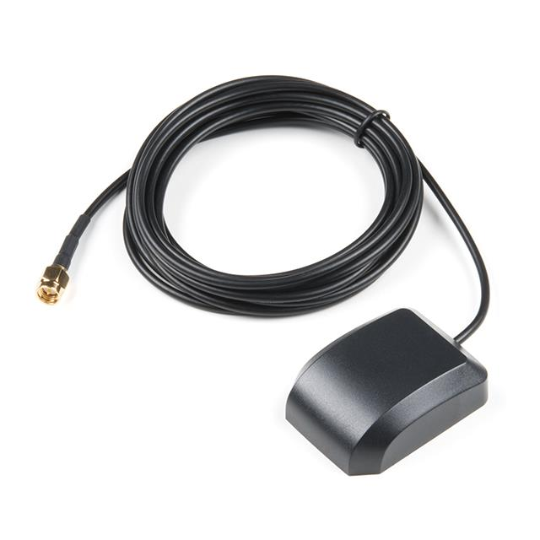
GNSS Receiver and Antenna
Sparkfun GNSS Receiver Breakout Board
Can communicate over UART and I2C
Uses a MAX-M10S receiver chip to read GNSS data
GNSS Antenna
Works in frequency range of 1.575GHz ~ 1.61GHz
If we want to read Galileo it operates at 1575.42 MHz
All these items were low in stock so we ordered them at the risk of long lead times.

Slide 41
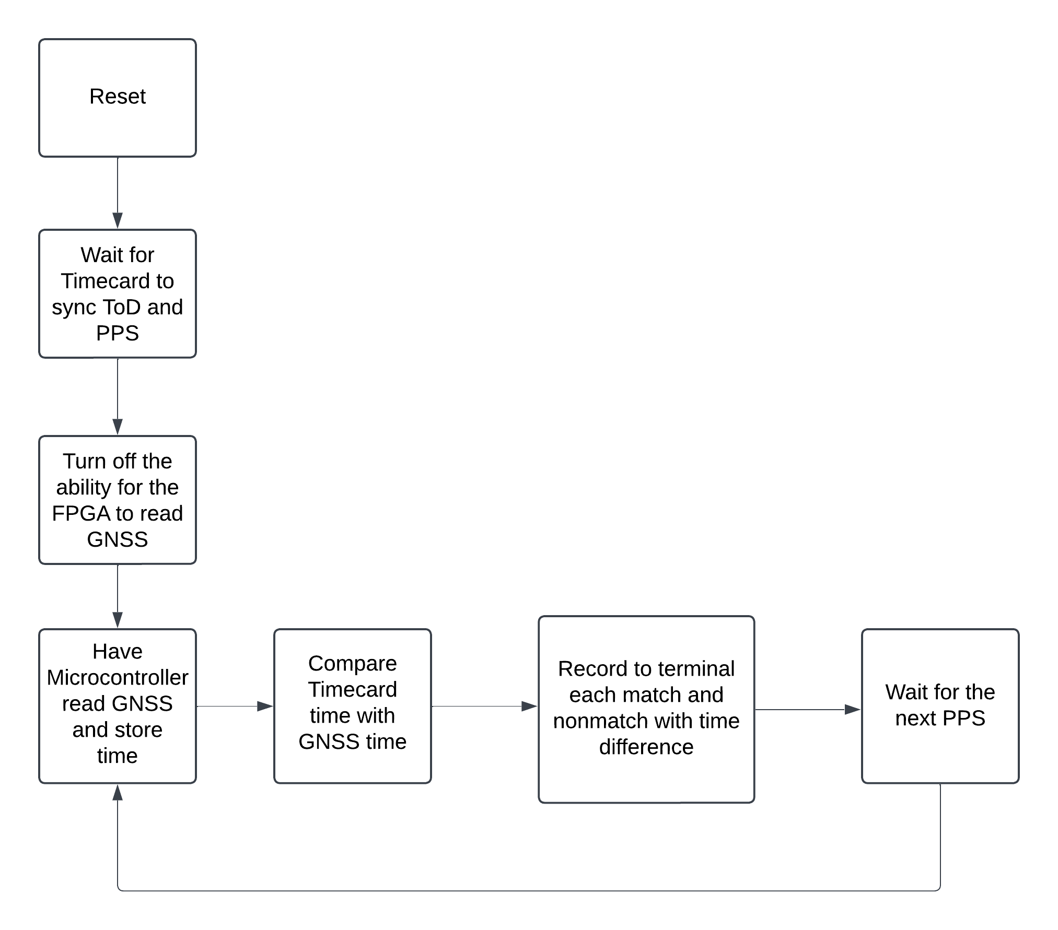
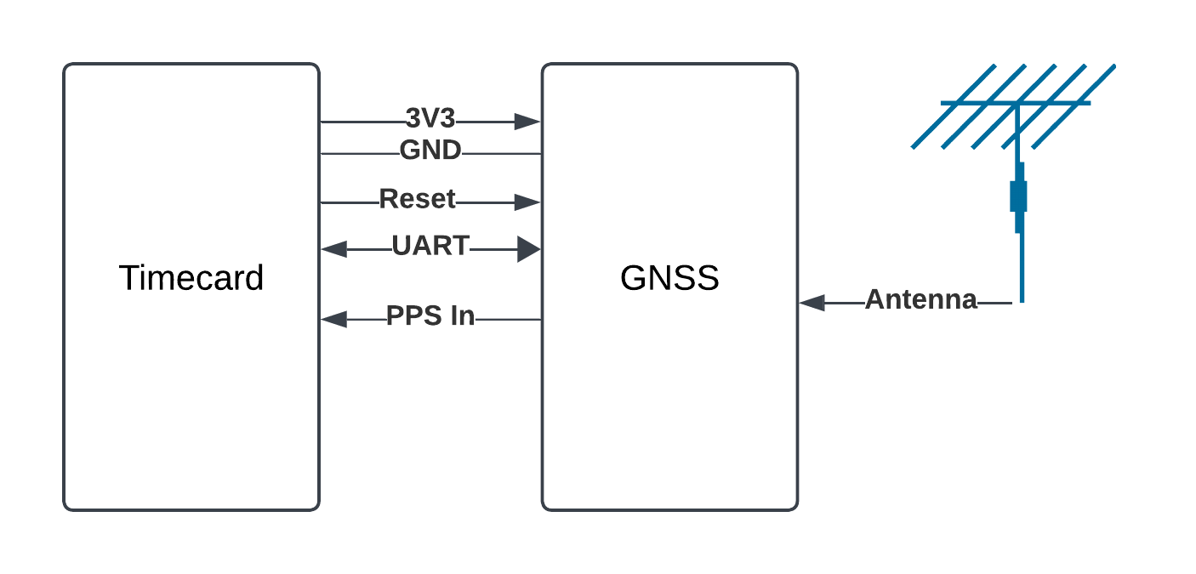
Example Setup for test

Slide 42
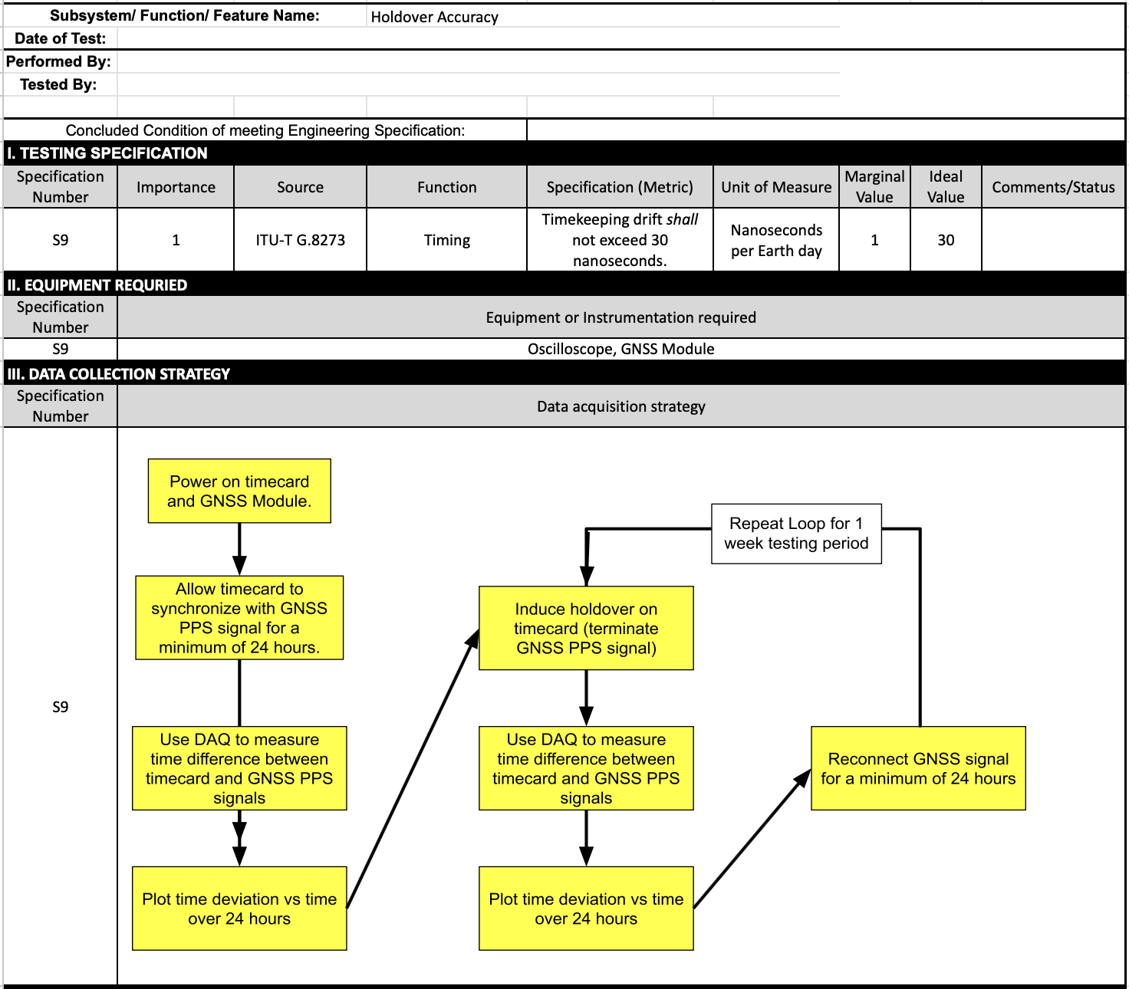
Test Plan: Holdover
Accuracy
Test plan to verify the accuracy of the timecard while in holdover.

Slide 43
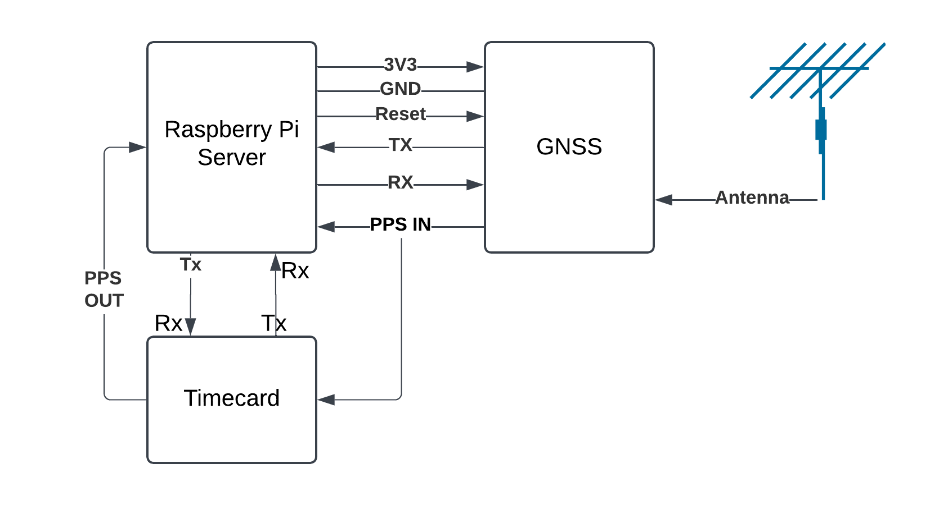
Test Plan - Raspberry Pi GNSS Server
The purpose of this test is to configure a Raspberry Pi to collect data from a GNSS module and relay it to the timecard. In its initial implementation, the data transfer will occur over UART, with provisions for transitioning to CAN once the interface becomes available.
Notes:
Luke

Slide 44
Test Plan System Overview
Power Supply: The GNSS module is powered by a 3.3V supply from the Raspberry Pi.
Communication: The GNSS communicates bidirectionally with the Raspberry Pi via UART.
PPS Signal: The GNSS provides a PPS (Pulse Per Second) signal, which serves as the PPS IN signal for the timecard. This is utilized by the DPLL on the timecard for synchronization.
Sync Time: Have a server that can pull the time from Galileo.
Programming Language: The server on the Raspberry Pi will be written in Python because the github repos for the GPIO are out of date.

Slide 45

Server Test

Slide 46
Open Items
CURRENT PHASE OPEN ITEMS
Open Design Items:
Currently no open design items, ahead of schedule and working through implementation.
FUTURE PHASE OPEN ITEMS
Open Implementation Items:
Implementation of feasibility design from MATLAB/SIMULINK into hardware via the SoC’s Programmable Logic (PL) and Processing System (PS)
Final implementation of PCB after prototype verification
Create emulated CubeSat motherboard on our Raspberry Pi 5
Open Testing Items:
Functionally verify implemented design
Demonstrate integration within our emulated CubeSat using the Raspberry Pi 5
Notes:
Ian

Slide 47

Gantt Chart
Personal Assignments can be viewed within summary reports.
Gantt Chart
Notes:
Tanner

Slide 48
Goals for Next Phase:
Upon exiting MSD 1 and entering MSD 2, the “Build and Test Prep” phase will be entered. As mentioned previously we are technically ahead of schedule, and we will be striving to our momentum. Our goals for the next phase include:
Furnish and order breakout board for the MicroZed 7010 SoM.
Furnish the time card complete PCB.
Assemble and test functionality of the SoM, CSAC, and TCXO
Furnish existing test plans and develop new tests as required.
Individual and generic goals can be found within current phase report.
Notes:
Tanner

